Slide 1
WORLD OF DRONE
Drone Components: Sensors and Actuators

Slide 2
SENSORS?
Position and movement sensors give information about the aircraft state.

Slide 3
SENSORS?
Exteroceptive sensors deal with external information like distance measurements, while exproprioceptive ones correlate internal and external states.

Slide 4
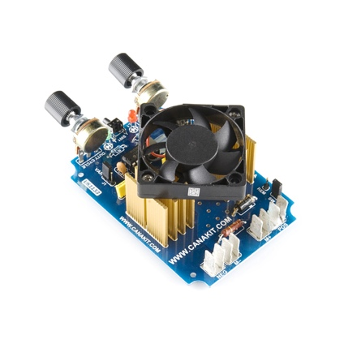
ACTUATORS?
UAV actuators include digital electronic speed controllers (ESC), which control the RPM of the motors.

Slide 5
ACTUATORS?
In addition, servomotors (for planes and helicopters mostly), weapons, payload actuators, LEDs and speakers.

Slide 6
?
WELL DONE!
Now you can move on to the next topic...
Drone Components: Flight Controller Board!

